Slide 1
Evaluation

Slide 2
Kuka→ Aruco Registration
29 calibration trials captures→ 5 for repeatability +24 for registration matrix
JSON Calibration
Get registration matrix ( source=JSON, target=aruco X24 trials)

Slide 3
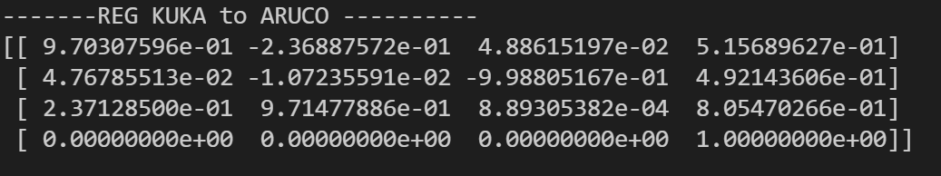
Registration matrix (24 trials)

Slide 4
Repeatability of Registration
Take 5 Trials ( 4 positions each)
Calculate their individual registration matrix T
Get mean and std of each T component ( for Rotation and translation matrices)
Calculate their respective bias
Calculate their respective TAE: total analytical error
***NOTE ALL IN standard units ( Meters)

Slide 5
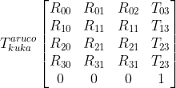
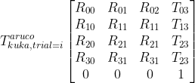
Registration matrix obtained from 24 trials = “Ground Truth”
Get registration matrix for each of the 5 trials used for repeatibiliyt.
Get their combined component means and std.
Compare with ground truth
Notes:
T_{kuka}^{aruco}\begin{bmatrix}
R_{00}& R_{01}& R_{02}& T_{03}\\
R_{10}& R_{11}& R_{11}& T_{13}\\
R_{20}& R_{21}& R_{21}& T_{23}\\
R_{30}& R_{31}& R_{31}& T_{23}\\
0& 0& 0& 1
\end{bmatrix}

Slide 6
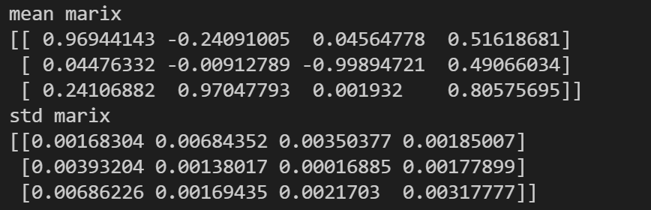
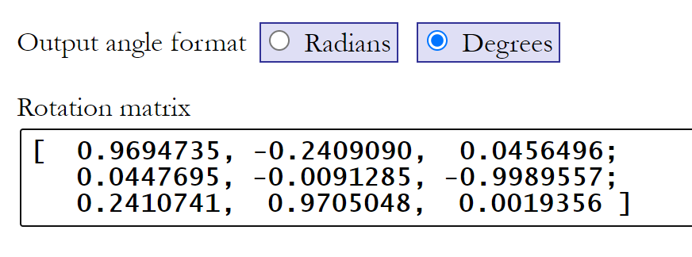
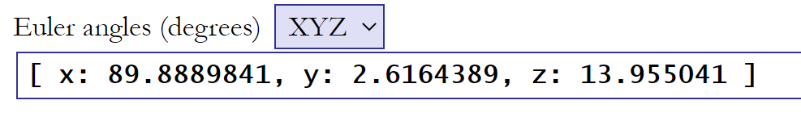
Mean Matrix [m]

Slide 8
